Slide 2
Security Information and Event Management
Immense amount of data
Firewalls, IDS, IPS solutions
Log, aggregate, normalize, review
Components
Security Information Management
Security Event Management

Slide 3
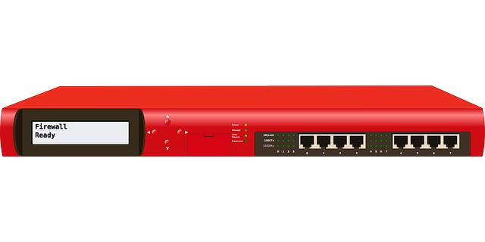
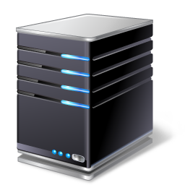

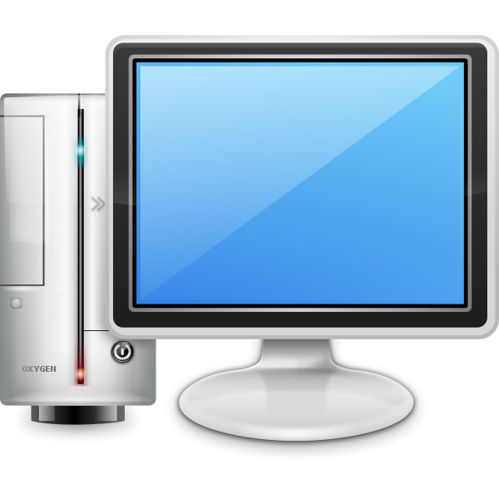


Security Information Event Management
Security Information Management(SIM)
Collects, stores and aggregates log data
Notes:
Security Information Management (SIM) involves
Log aggregation
Collecting
Normalizing
Analyzing log data
Data inputs across your network,
Firewalls
Servers
Anti-malware software.
Syslog
Example Splunk Connectors
https://www.splunk.com/en_us/platform.html

Slide 4

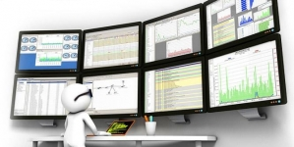



Security Event Management
Security Event Management (SEM)
Notes:
Security Event Management (SEM)
involves event data for
Real-time threat analysis
Visualization
Incident response
Threat intel features to flag activities
Threat feeds, advisories, bulletins, CVEs and CVSS
Like suspicious authentications
Logins based on up-to-date lists of known bad actors.
Incorporates User and Entity Behavior Analytics, Sentiment Analysis insider threats) not just anomaly-based detection
sentiment analysis example may be performed on Twitter to determine overall opinion on a particular trending topic.
https://www.solarwinds.com/security-event-manager/siem-tools

Slide 5
Security Orchestration Automation Response
SIEM response is a very manual
Provides an automated response
Streamline the response process
Used in conjunction with a SIEM
Notes:
Security Orchestration
https://swimlane.com/platform

